Slide 1
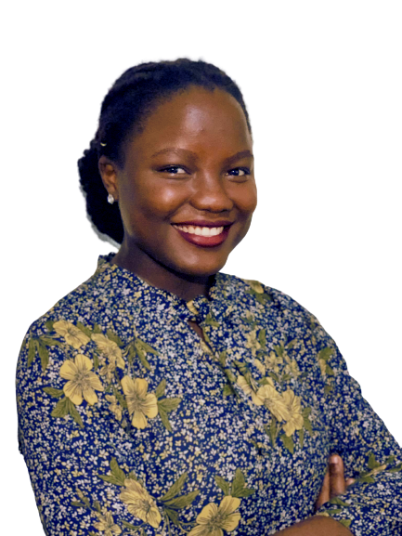



Kampala
WELCOME TO
01
OSCA - Kampala
Sub theme: "Exploring Opportunities in Open Source"
Guest speaker:
AANYU DEBORAH ODUMAN
Computer Engineer/ Web developer/ Open source contributor

Slide 2
SUMMARY
Kampala
About me
My OSS story
What is Free and Open Source software?
Examples of Open source organisations
Why communities choose to go open source.
How you can contribute.
Where to start
How to start.
How you will benefit from being a contributor?
Great opportunities to pursue
Great OSS communities to join
Important resources
How you can reach me
02
Table of Contents
Presentation Outline

Slide 3
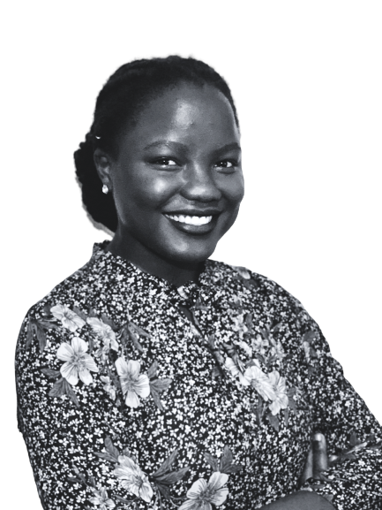
Kampala
About
Me
03
aanyudeborah.me
•OSCA – Kampala chapter co-lead
•Computer Engineer, self taught web developer, technical writer, open source contributor
•Contributed to FOSS communities such as Mixxx, Tor and Curious Learning as a technical writer
Notes:
Other titles you will find on my LinkedIn:
-Consultant
-Social media manager
-Secretary with a small microfinance in Soroti.
-Got introduced to the world of development in university through the Andela web dev programs (Andela Women's initiative) among others. opportunities opened from there on.
-My writing background: I had a lot of writing experience through my activities in high school as an amateur novelist which later led to my appointment as Writer's Club president.

Slide 4
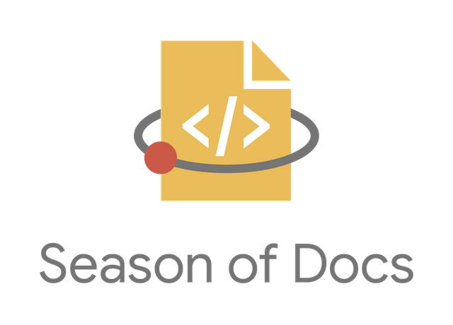




FOSS programs:
Kampala
My FOSS Story
04
FOSS communities:
My firsts:
Notes:
I started in lockdown of 2020 with a single tweet.
Outreachy is a diversity initiative that provides paid, remote internships to people subject to systemic bias and impacted by underrepresentation in the technical industry where they are living.
During this internship, interns are:
💵 Paid - $6,000 USD total internship stipend
🌍 Remote - both interns and mentors work remotely
🕰 3 months - internships run May to August, or December to March
Mixxx is a free/open-source DJ performance software for Windows/Mac/and Linux that integrates the tools DJs need to perform creative live mixes with digital music files.
https://mixxx.org/
Google Season of Docs is a program that provides support for open-source projects to improve their documentation and gives professional technical writers an opportunity to gain experience in open source. In essence raising awareness of open source, of docs, and of technical writing.
Curious Learning works with partners to curate & localize and distribute & measure free open source apps that empowers everyone to have the opportunity to learn to read.
https://www.curiouslearning.org/mission

Slide 5
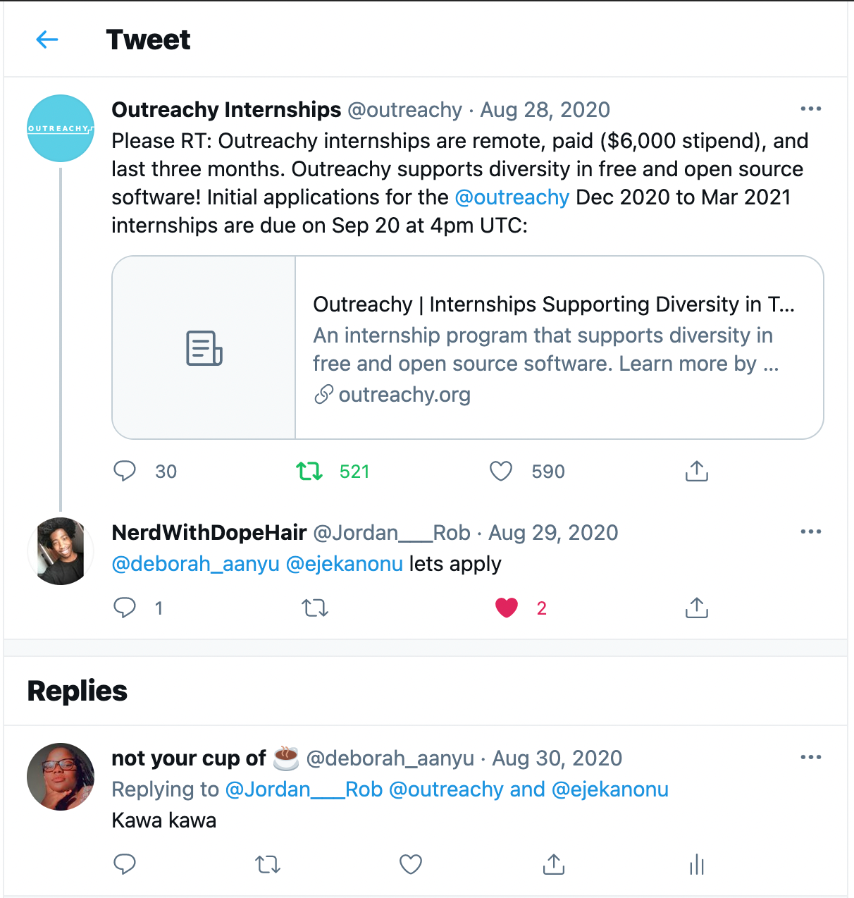
Kampala

Slide 6
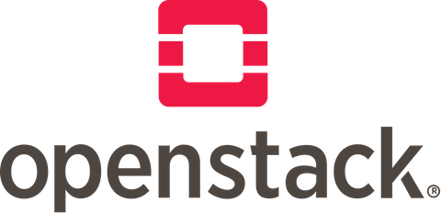







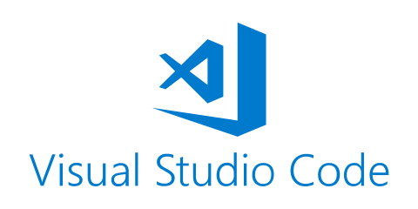
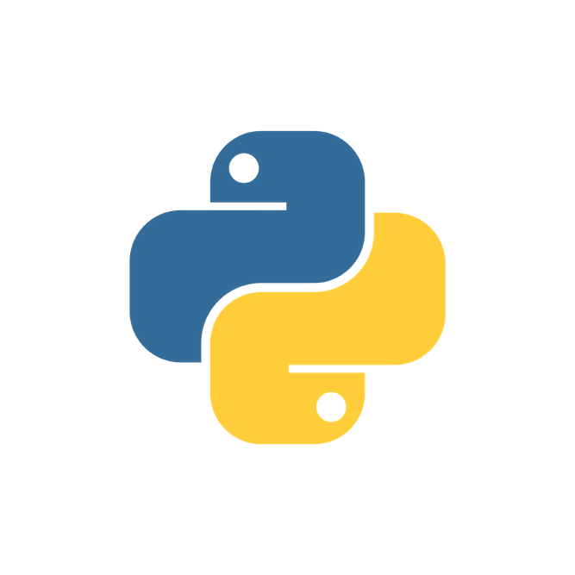

Kampala
De-mystifying Open source
FOSS is software with source code that anyone can inspect, modify, and enhance.
Source code is made available publicly for others to to view that code, copy it, learn from it, alter it, or share it.
05
What is Open source software?
Examples
Notes:
There are not a lot of platforms promoting the agenda of OSS here in Uganda - why? There were not a lot of people i could reach or consult or talk to about the OSS programs, even in a lot of the dev circles that we all know.
There could be some mystery about OSS, and i felt that the level of awareness about it was low. SO lets debunk it.
Open-source software is freely licensed to use, copy, study, and change the software in any way, and the source code is openly shared so that people are encouraged to voluntarily improve the design of the software. This is in contrast to proprietary software, where the software is under restrictive copyright licensing and the source code is usually hidden from the users.
The term "free software" does not refer to the monetary cost of the software at all, but rather whether the license maintains the software user's civil liberties ("free” as in “free speech,”).
It is however common to find software that is open source and free in terms of monetary cost.

Slide 7
Kampala
Devoted to the advocacy, legal aid, financial aid, technical aid, governance, etc. of free and open-source software (FOSS)
To provide a mechanism for funding development of the software for example SFC
For the most part, these organizations are structured as non-profit/charity organizations.
Does not include companies that aim to make money from free and open-source software.
06
Open-
Source
Organisations
What are they?
Notes:
They are devoted to the advocacy, legal aid, financial aid, technical aid, governance, etc. of free and open-source software (FOSS) as a whole, or of one or more specific FOSS projects.
For projects that have their own foundation or are part of an umbrella organization, the primary goal is often to provide a mechanism for funding the development of the software.
For the most part, these organizations are structured as non-profit/charity organizations.
This list does not include companies that aim to make money from free and open-source software.

Slide 8




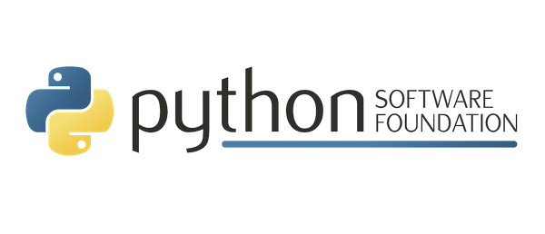


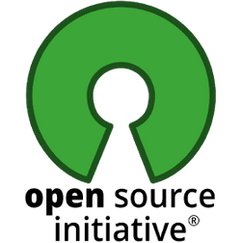

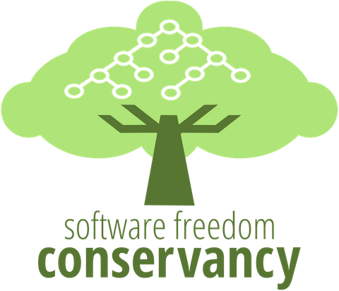


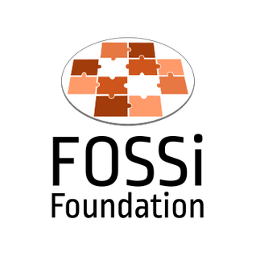


Kampala
16
Open
Source Foundations
07
Examples

Slide 9








Cost
Kampala
Collaboration and sharing
Why communities go Open Source
Control and Customisation
08
Training developers into better programmers
Security
Stability
Compared to proprietary software
Community growth
To allow OSS enthusiasts to give back to the community
Notes:
Cost: Because Open-source software is free to use, distribute, and modify, It has lower costs, and in most cases this is only a fraction of the cost of their proprietary counterparts.
Control: Many people prefer open-source software because they have more control over that kind of software. They can examine the code to make sure it's not doing anything they don't want it to do, and they can change parts of it they don't like. Users who aren't programmers also benefit from open-source software, because they can use this software for any purpose they wish—not merely the way someone else thinks they should.
Training: Other people like open source software because it helps them become better programmers. Because open-source code is publicly accessible, students can easily study it as they learn to make better software. Students can also share their work with others, inviting comment and critique, as they develop their skills. When people discover mistakes in the source code, they can share those mistakes with others to help them avoid making those same mistakes themselves.
Security: more secure and stable than proprietary software. Because anyone can view and modify open source software, someone might spot and correct errors or omissions that a program's original authors might have missed. And because so many programmers can work on a piece of open-source software without asking for permission from original authors, they can fix, update, and upgrade open-source software more quickly than they can proprietary software.
Stability: Programmes can be their tools that won't disappear or fall into disrepair if their original creators stop working on them. Additionally, open-source software tends to both incorporate and operate according to open standards.
Community: Not just a fanbase that buys in (emotionally or financially) to an elite user group; it's the people who produce, test, use, promote, and ultimately affect the software they love.

Slide 10
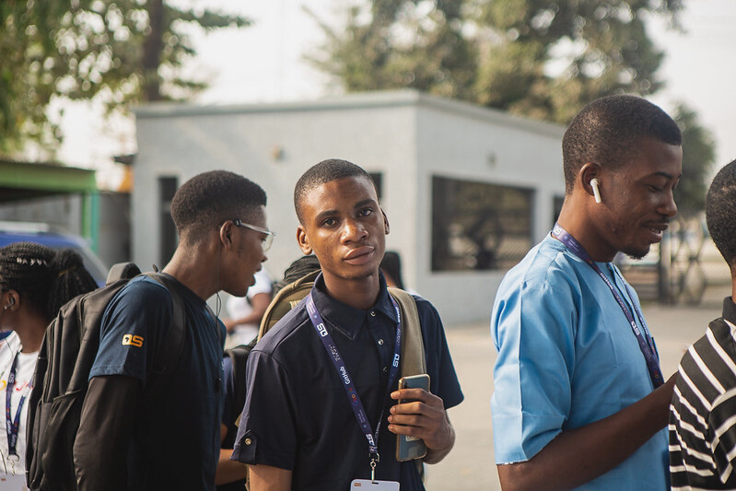
Graphic design and Art
Programming/ code
Documentation writing
Testing
Localization (translation)
Voice artistry
Filing bug reports and making recommendations
Donations, memberships and subscriptions, product purchases, paid support
Data science
project marketing
Kampala
How you can contribute to FOSS
09
Notes:
No. Open source technology and open source thinking both benefit programmers and non-programmers.

Slide 11
Where to start?
Self awareness
Skill requirements of project
10
What are your interests or talents? What skills do you have? What programming languages are you proficient in?
What are the skill requirements of the FOSS project you’re looking to contribute to?
Do you fit into the community?
Get to know GitHub
Do you feel comfortable interacting with the community members? Project guidelines. Procedures to filing issues and bug reports, etc
I thought i knew GitHub until I started contributing to my first opensource project
Notes:
Okay, now I have understood the gist of Open source. Where do I start?

Slide 12
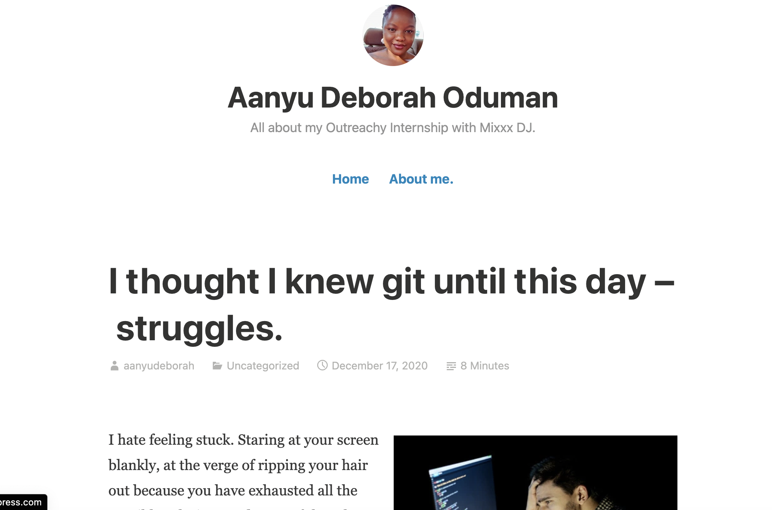

Slide 13
How to start?
11
Understand
Acquaint yourself
See it for yourself
Community
Understand the project's goals, objectives. What they’re trying to achieve? How do you fit into that picture?
What role will you play? Read and understand the contribution guidelines/ documentation
Join the relevant communities and channels and get acquainted with community members.
demo the project on your computer to have a better understanding
Continued on next slide...
Notes:
Now that you’ve found a community to contribute to, how do you start?
Contribution guidelines can be found on the project repository's README.md or CONTRIBUTING.md

Slide 14
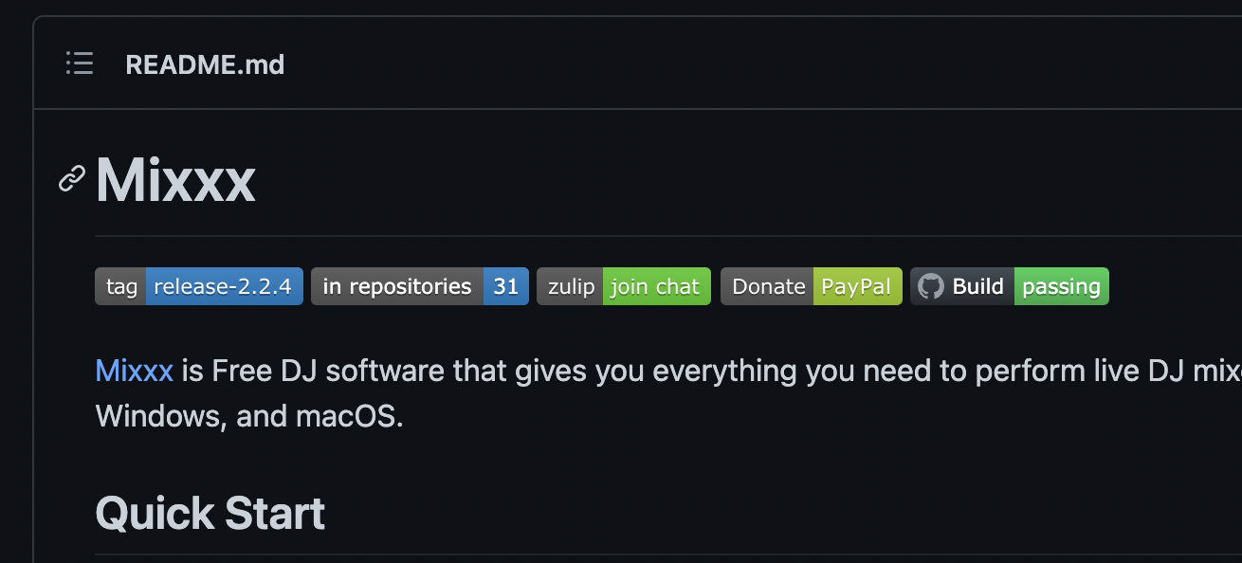
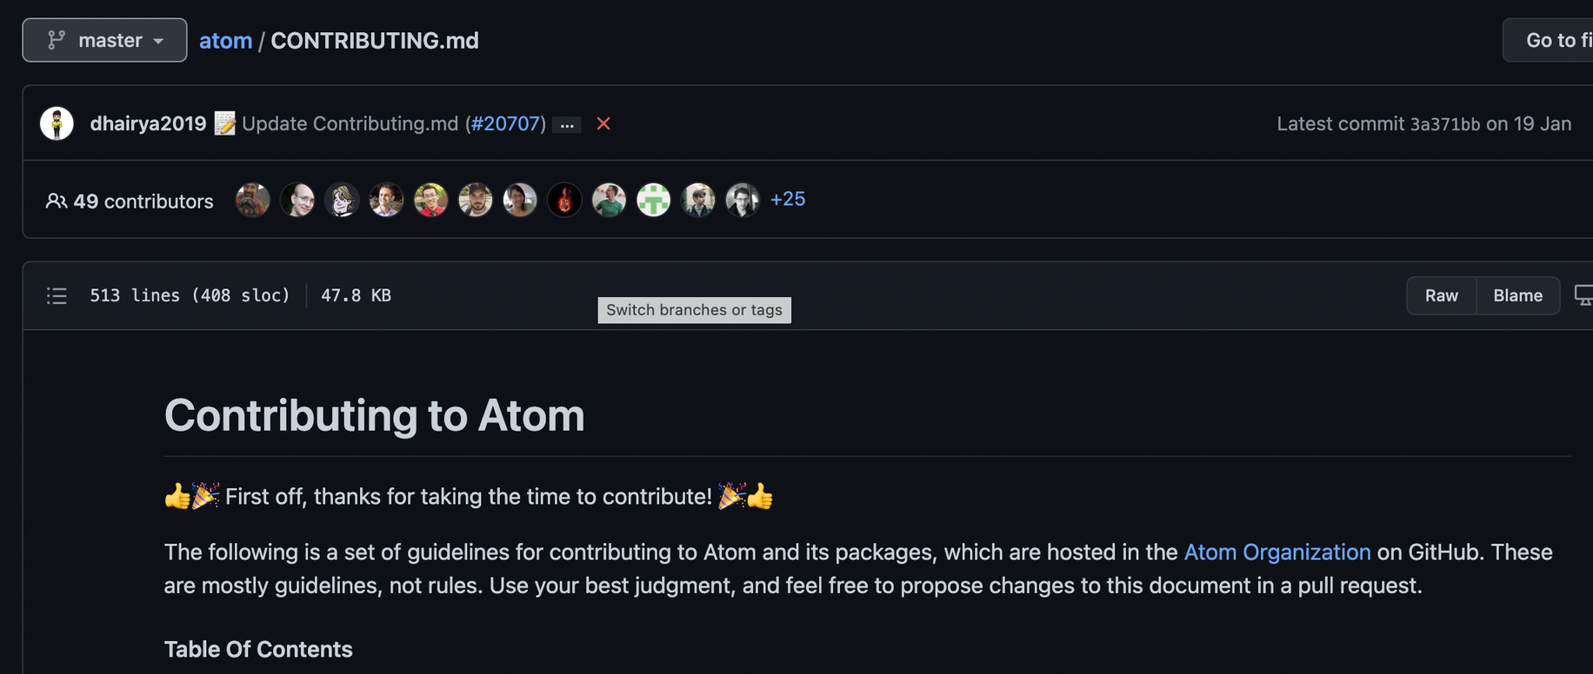

Slide 15
How to start.... cont'd
12
First issues
Ask for a review
Test your code
Examples
“beginner-friendly”, “first-timers-only” or similar labels if you’re contributing for the first time.
•Ask for review/ constructive criticism from a pro-community member on your opened contributions.
Write tests for your code if the GitHub repo doesn’t have inbuilt automated tests
https://docs.djangoproject.com/en/3.2/, https://opensource.microsoft.com/, https://mixxx.org/, https://www.videolan.org/vlc/, https://www.python.org/
Continued...
Notes:
Tag long time community contributors or mentors of the community to review your code.
Examples.
Most OSS websites have a dedicated tab for contribution guidelines and community.
Django
microsofts' open source website
VLC media player
Mixxx

Slide 16
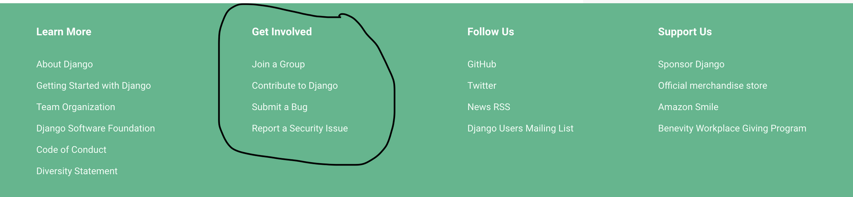
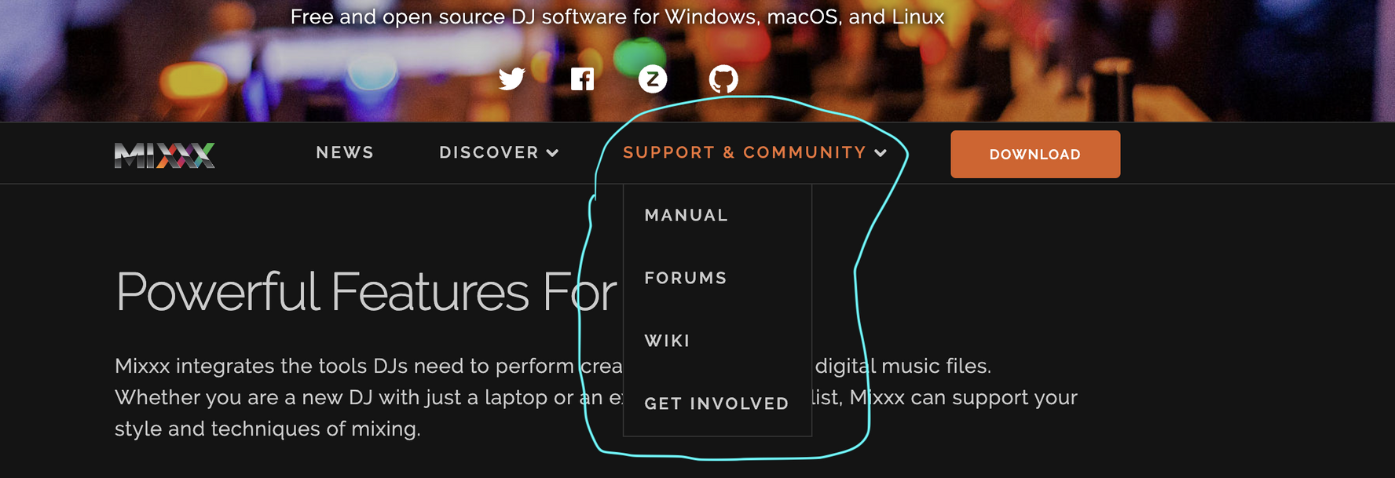

Slide 17
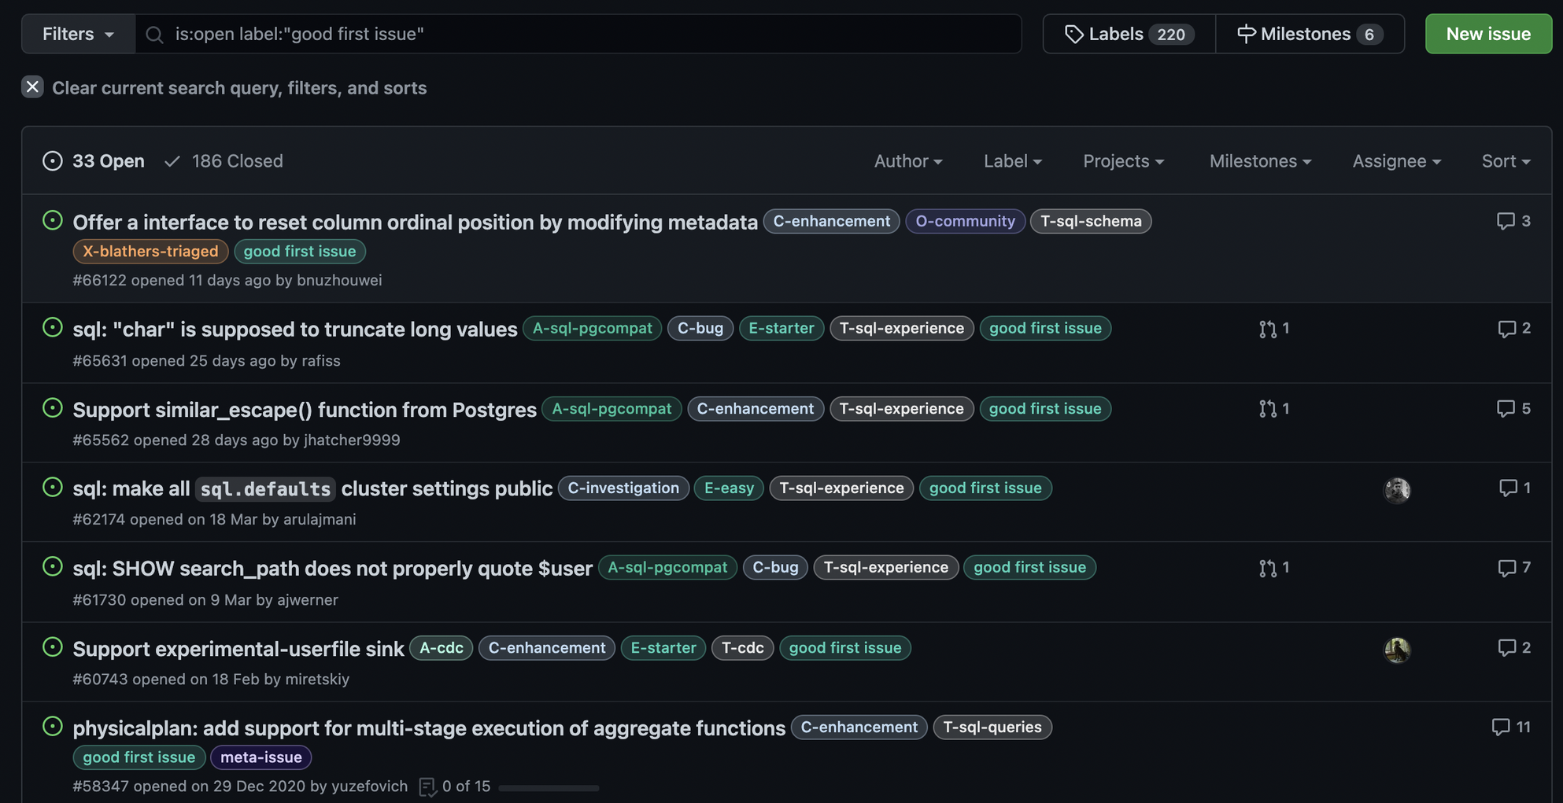
https://goodfirstissue.dev/
Notes:
This site curates easy pickings from popular open-source projects, and helps you make your first contribution to open-source.

Slide 18
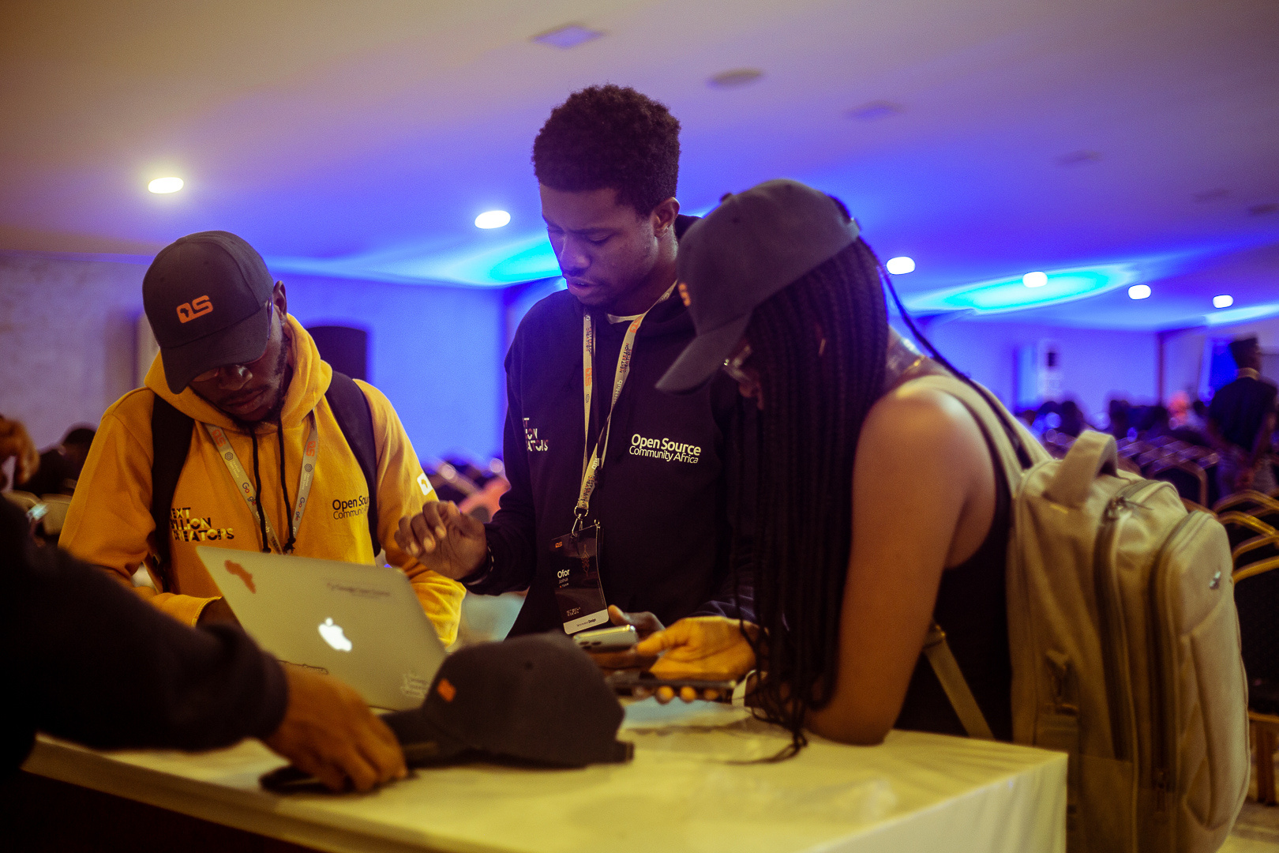
WHAT'S IN IT FOR YOU?
How will you benefit from being a FOSS contributor?
13

Slide 19
Kampala
Exposure
Network
Get hired
To a lot of great opportunities in open source
With a lot of awesome individuals in the FOSS world – and learn from them, and build yourself.
Familiarity with contributing to FOSS is an added + for a lot of job opportunities.
14
Be the change you want to see in the world
Get paid
Through incentivised FOSS opportunities like Outreachy, GSOD, GSOC, among others.
Recogniton
impart a lot of positive change in the world through your contributions.
Get recognised for your contributions to FOSS (authors.md)

Slide 20
Kampala
Great programs to get started
15
FOSS program
Duration
Paid/ Incentivised?
Starter friendly
Outreachy
3 months
$ 6000
Yes
Google Summer of
Code
Depends on country and other factors
3 months
No
Major League Hack
3 months
$ 5000 + swag
No
GirlScript Summer of
Code
Yes
3 months
$ 3000 - 6600
Google Season of Docs
Depends
Varies
Yes
Notes:
Links to a lot of other programs is the resources slide

Slide 21


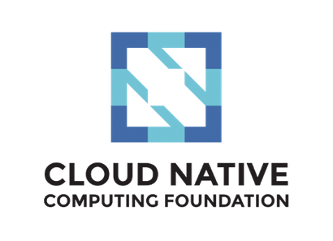
Kampala
Great FOSS communities to learn from
16
FOSS Asia
Open Source Community Africa
She Code Africa
Write the Docs

Slide 22

RESOURCES
Kampala
A full list of open-source programs that you can apply to: https://github.com/tapaswenipathak/Open-Source-Programs
MLH open-source program https://fellowship.mlh.io/programs/open-source
Outreachy: https://www.outreachy.org/
Making money from open source projects: https://dev.to/techthor/making-money-from-open-source-projects-2mmb
Google Summer of Code https://summerofcode.withgoogle.com/
My first experience with open source (with advise): https://aanyudeborah.wordpress.com/
17
Useful resources:

Slide 23





SOCIALS
Kampala
OSCA Kampala Discord server
https://discord.gg/KmQueTTeNU
You can reach out to me on:
Twitter
18
https://twitter.com/deborah_aanyu
Website
www.aanyudeborah.me
LinkedIn
https://www.linkedin.com/in/deborahaanyu/
For questions or concerns
Website
www.aanyudeborah.me
Email Address
deborahtrez12@gmail.com

Slide 24
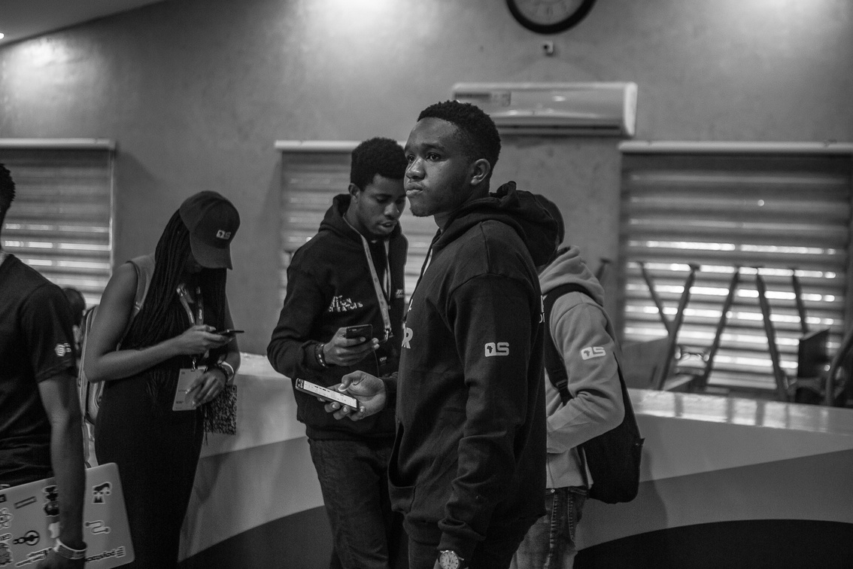
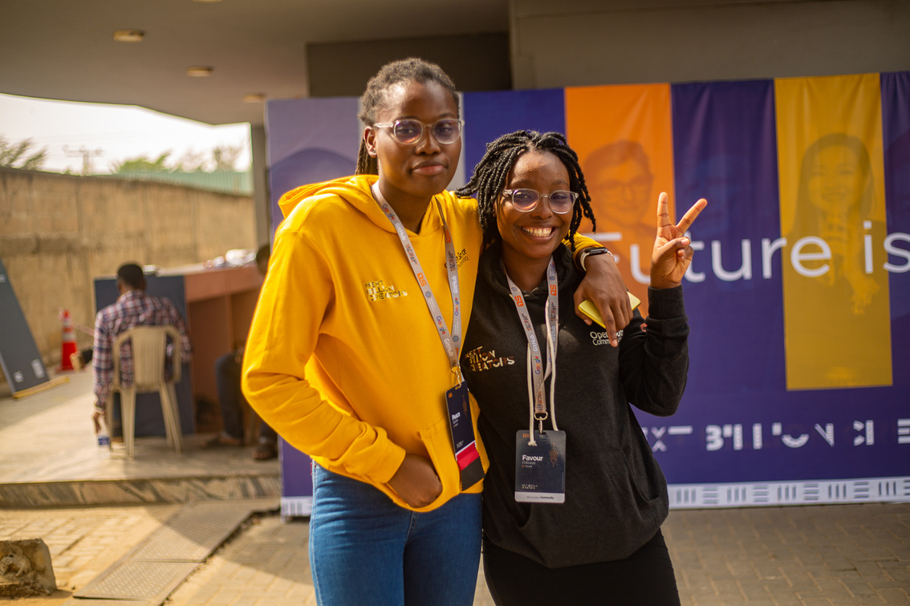
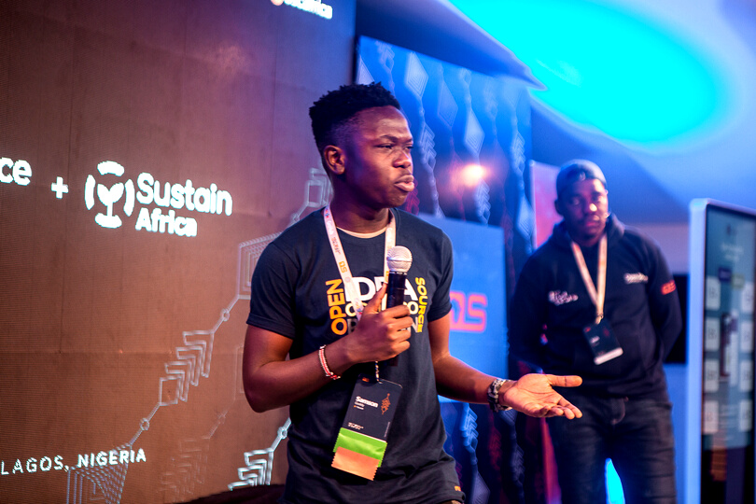
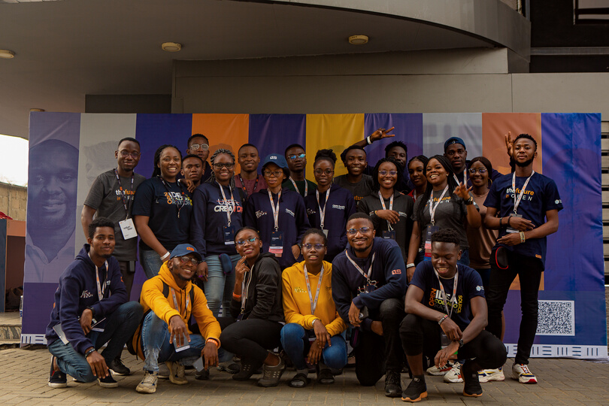
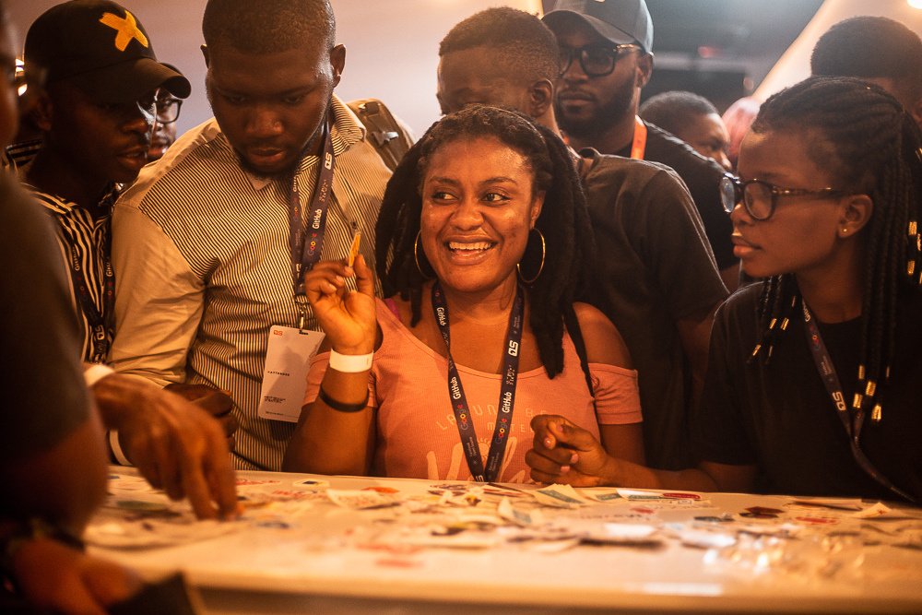
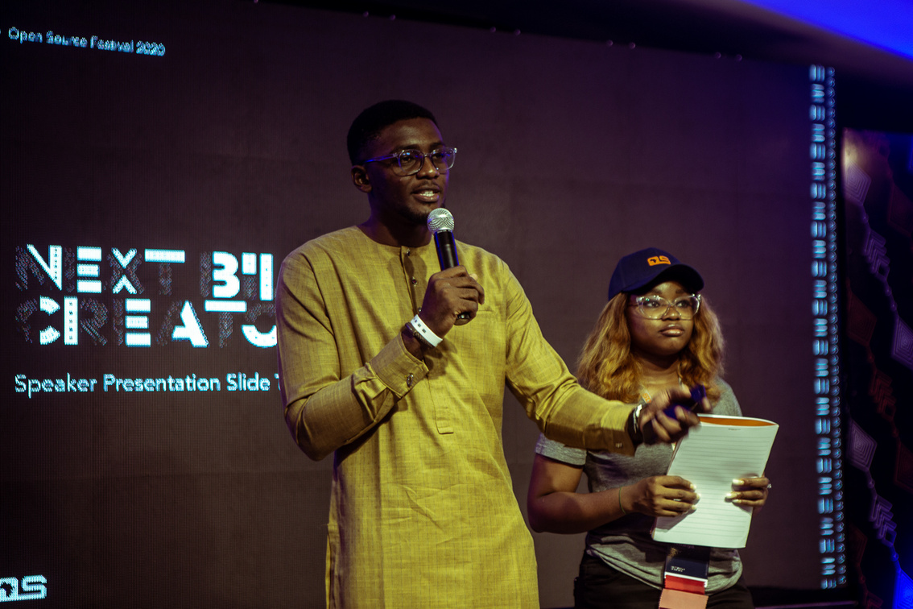
Kampala
19
THANK
YOU !
https://www.oscafrica.org/
https://innovationvillage.co.ug/

